Slide 1
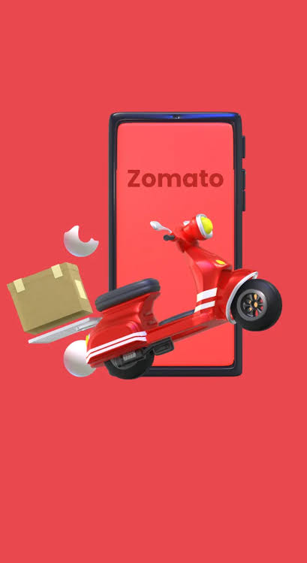
ZOMATO
Delivery Operations Analysis
A Tableau dashboard analyzing 45,584 deliveries to uncover operational risks and efficiency opportunities
45,584
26.29 min
4.63 / 5
Orders Analyzed
Avg Delivery Time
Avg Rating
Prepared by Shibla Nasreen | Tool: Tableau Public | Source: Kaggle

Slide 2
About the Dataset
Zomato Delivery Operations Analytics Dataset • Source: Kaggle
Key Fields
Description
ID
Time_Ordered
A comprehensive view of food delivery operations — covering delivery person details, order timestamps, weather conditions, traffic, and more. Used here to explore patterns, evaluate delivery performance, and surface insights to enhance customer satisfaction.
Delivery_person_ID
Time_Order_picked
Delivery_person_Age
Weather_conditions
Delivery_person_Ratings
Road_traffic_density
How the data can be used
Restaurant_latitude
Vehicle_condition
Delivery performance analysis — ratings, times, vehicle condition
Route optimization using location and traffic data
Customer experience insights from weather & festival patterns
Operational insights on order volume and multiple deliveries
Restaurant_longitude
Type_of_order
Delivery_location_latitude
Type_of_vehicle
Delivery_location_longitude
Multiple_deliveries
Order_Date
Festival
City
Time_taken (min)
45,584 rows • 20 columns

Slide 3




Project Objective
Zomato's delivery network handles thousands of orders daily across Indian cities. This project analyzes operational and external factors affecting delivery performance to identify where the business should focus improvement efforts.
External Factors
Weather, traffic, festival impact
Delivery Resources
Vehicle type, condition, partner demographics
Guiding Question
“What operational and external factors most affect delivery performance, and where should Zomato focus improvement efforts?”
Geographic Spread
Restaurant and delivery locations
Operational Patterns
Timing, scheduling, multiple deliveries

Slide 4





Executive Overview
45,584 deliveries analyzed across Indian cities
45,584
26.29 min
4.63 / 5
Total Orders
Avg Delivery Time
Avg Rating
1,320
34.12%
9.99 min
Delivery Partners
Vehicles in Good Condition
Avg Prep Time

Slide 5

External Factors: Weather & Traffic
Conditions outside Zomato's direct control still shape delivery speed
Festival deliveries take 45.5 min on average vs 25.98 min normally
— a 75% increase. Even the fastest festival delivery is slower than the average normal-day delivery.

Slide 6
Delivery Resources: Vehicles & Partners
Fleet condition matters more than vehicle type or partner age
34.12%
4.5 – 4.6
of the fleet is in Good/Excellent condition — poor-condition vehicles add nearly 6 minutes of delay.
rating range across all delivery-partner age groups — age has minimal effect on service quality.

Slide 7
Geographic Delivery Network
Restaurant and delivery locations mapped across Indian metro regions
Restaurant Locations
Delivery Locations
Clustered across major Indian metros and surrounding urban regions
Consistent coverage across Urban, Semi-Urban and Metropolitan zones
Full interactive maps available in the live Tableau Public dashboard

Slide 8


Operational Insights
Multiple simultaneous deliveries is the single biggest driver of delay
+109%
increase in delivery time when 3 orders are combined vs a single delivery (22.9 → 47.8 min)
Weekdays generate 2.6x more orders than weekends (33,049 vs 12,535) — with no meaningful difference in delivery speed.

Slide 9
Key Findings
Multiple deliveries is the biggest risk
Festivals disrupt performance sharply
Delivery time nearly doubles (22.9→47.8 min) when 3 orders are combined.
45.5 min avg vs 25.98 min normally — a 75% slowdown.
Weather & traffic add secondary delay
Vehicle condition outweighs vehicle type
Fog/cloud adds ~7 min; jam traffic adds ~10 min vs best case.
Only 34% of the fleet is in good/excellent condition.
Partner age has minimal effect
Weekdays drive order volume
Ratings stay consistent (4.5–4.6) across all age groups.
2.6x more orders on weekdays, with no speed penalty.

Slide 10
Recommendations
Priority actions based on the analysis
1
Cap simultaneous deliveries at 1 additional order per trip to control the largest source of delay
2
Deploy a festival operations protocol — extra drivers, pre-positioned vehicles, proactive delay alerts
3
Prioritize vehicle maintenance to raise the good/excellent fleet share above the current 34%
4
Set weather-adjusted delivery estimates (+5–8 min) during foggy/cloudy conditions
5
Maintain age-neutral hiring, since performance is consistent across delivery partner age groups

Slide 11
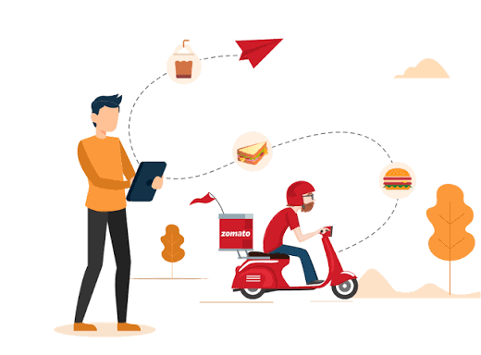
Thank You
Questions & discussion welcome
Shibla Nasreen
Doha, Qatar
Tableau Public • LinkedIn • GitHub

